Slide 1
VIRTUAL ASSISTANCE
Affordable EV Webinar
Notes:
PRESENTER 1 :

Slide 2
OUR MISSION : LESS EMISSIONS
Webinar Sponsors:
Notes:
PRESENTER 1 :
We are the EVs for Everyone/EVs Para Todos campaign with Ecology Action. Ecology Action was created in 1970 as an environmental non-profit that started as a recycling center, and today, our focuses are transportation, water conservation, and energy efficiency to reduce greenhouse gas emissions, at scale. We work to make equitable impacts to our community and the folks living in it.
I’d like to shout out to our sponsors PG&E and California Energy Commission who make it possible for us to conduct our work.
I am _____(Name and Title)_____ and I will be presenting with __(Name and Title)__

Slide 3
AGENDA AND TRAINING OBJECTIVES
BUYING OPTIONS
FINANCIAL INCENTIVES
BENEFITS FINDER
EVS, PLUG-IN HYBRIDS & CHARGING
Purchase Scenarios
Find out how much YOU can save!
Notes:
PRESENTER 1 :
The objectives of this webinar are to
Introduce you to buying options and types of EVs
Provide a quick review of EV options, and
We will also go over the Access Clean CA income verification process for state grant and rebate applications so that you’ll receive all the benefits you qualify for when you are ready to purchase an EV!

Slide 4
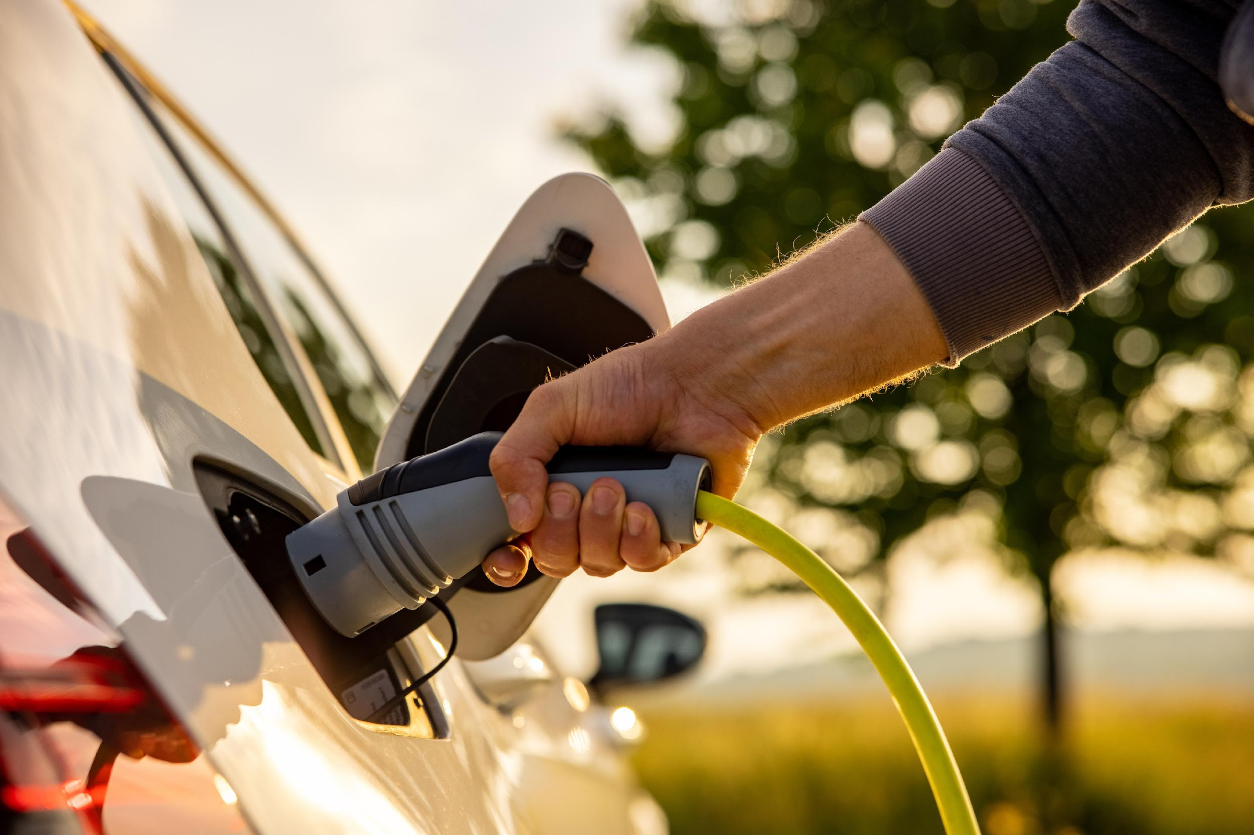
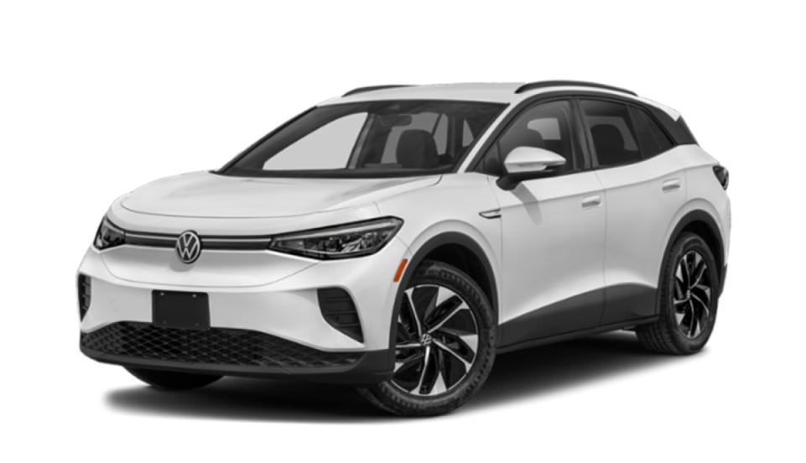
POLL
EV ASSOCIATION
Notes:
Presenter 1 What are your thoughts on driving electric?

Slide 5
POLL
Range
Notes:
Presenter 1 “As of 2023, What is the average range of a new all-battery electric vehicle?”

Slide 6
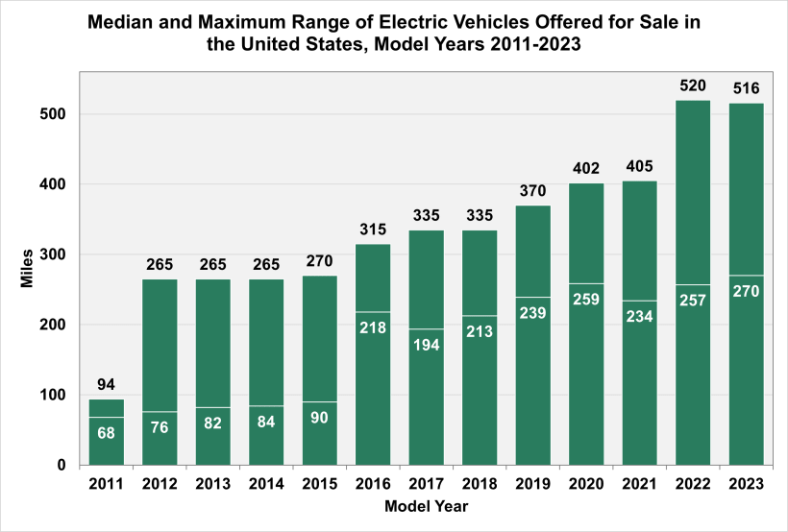
On the Rise:
The Range of EVs from 2011 to 2023
Range depends on:
make
model
Expect to see more affordable models at lower ranges and the luxury brands to be closer to 400!
Source: US Department of Energy
Notes:
Kalia
Range is on the rise! Over the past decade we have seen tremendous growth in the average range of electric vehicles. Now the 259 is an average- so it will depend on the make, model, and type of electric vehicle. With higher end all battery models like Tesla, you’ll see the 300 to 400 range. However more affordable PHEV models will be lower around 50 to 100 miles per charge
Range is on the rise and, over the past decade, we have seen range in vehicles increase drastically. You can see in the chart on the right that the average range of a new EV is around 270 miles.
We expect the range to only increase with time, but ranges have never been higher, and it is a great time to purchase an EV. In 2024, new vehicles will be released with a range from 300 – 400 miles, such as the Chevy Equinox, Chevy Blazer, and the Chevy Silverado.
Range depends on the type of electric vehicle you get. You can expect higher ranges with luxury models and lower ranges with more economical models.

Slide 7
WHICH EV IS RIGHT FOR ME?
Overview of Battery Electric and Plug-in Hybrids
Notes:
PRESENTER: Kalia

Slide 8
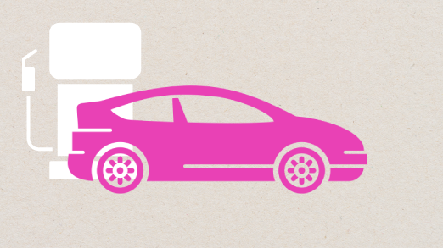
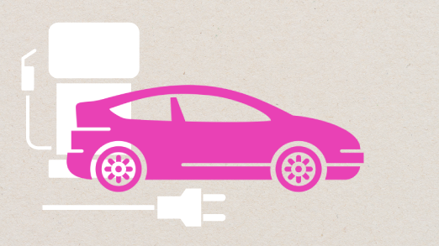
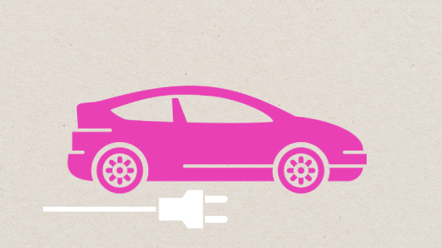
Types of Electric Vehicles
Hybrid No Plug | Plug-in Hybrid (PHEV) Refuel it and Plug it in | 100% Electric (BEV) Zero Emissions
RANGE | RANGE | RANGE
Features a dual engine, the primary (combustion) and an electric motor. The battery recharges when the vehicle reduces speed. | Combines a combustion engine and an electric motor which is primarily used. The battery charges when the vehicle reduces speed or directly when plugged in. | Exclusively electric drive and all its power and range comes from its high-capacity rechargeable battery. The battery recharges when the vehicle reduces speed and directly when plugged in.
Notes:
there are 3 types of electric vehicles Hybrids, plug-in hybrid electric vehicles, Battery electric vehicles
To help you understand it, you can interpret this chart from left to right as being the most similar to a conventional gas vehicle to the most different from a gas car.
- hybrids are the closest to a gas vehicle. They have an extremely efficient engine because it is supported by an electric motor that charges through braking. While this car has electric assistance, you do not charge it in any capacity and would fuel up at a gas station, just like a gas car but with less frequent needs to fuel up.
- The Plug in Hybrid is in the middle because it combines both an electric battery and a gas tank. It has a shorter range battery that can be supplemented through its gas tank. You charge it and you do fill it gas.
- Our last type of EV is an all battery electric vehicle. These cars run purely on electricity. You will not be stopping at the gas station- you will be charging at your local charger or at your house.

Slide 9
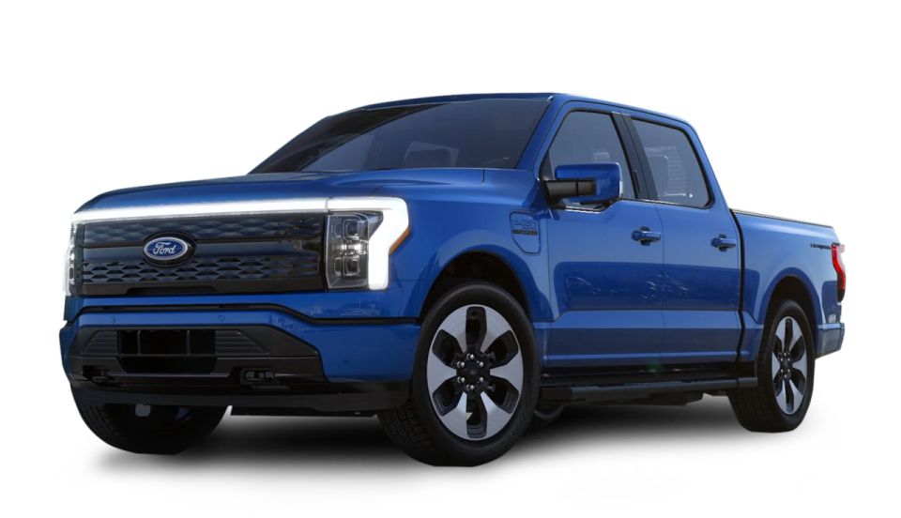
Buying Options
Purchasing Guide
All-Battery Electric Vehicles
CONSIDER IF
AVERAGE RANGE
Access to charging at home or work is available
Daily commute distance is within battery range
100-300
Miles/per charge
Notes:
Kalia
An all-battery electric vehicle runs off pure electricity. There is a wide range depending on model, but they get roughly anywhere from 100-300 miles per charge.
You should consider a BEV if:
You have access to charging at home. You will need to be charging it as gas is not an option so having home charging is ideal. This is great because with the charging being installed on your property you will have access to convenient and affordable charging.
Daily commute distance is within battery range: When you’re considering which EV model you prefer, consider how much and where you are driving daily.
For example, say that I am someone who has to regularly commute to Oakland for work. I live in Santa Cruz so that’s roughly 150 miles round trip.
If you get a Bolt that has about 250 miles, you could drive to Oakland and back before needing to charge.
It’s important to really look at your commute and see how much you are driving when considering which EV model is best for you.
If a BEV is what you need. A new model is closer to $40k and used sit roughly around $25k.

Slide 10
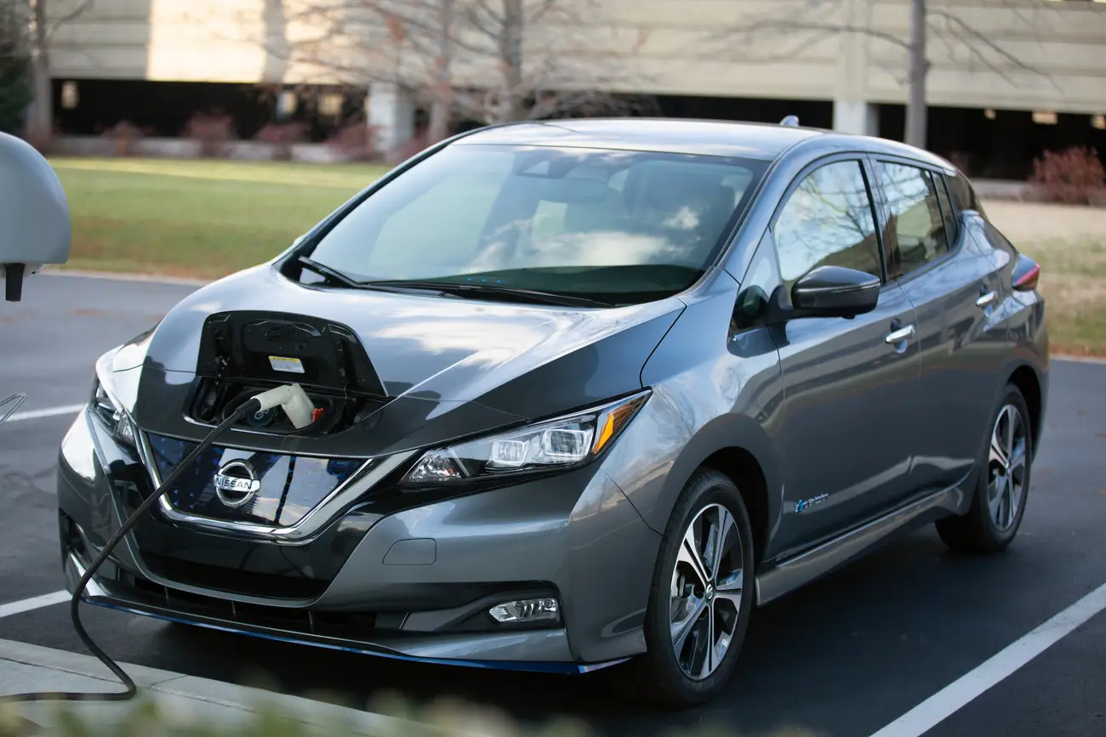
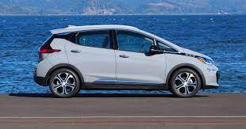
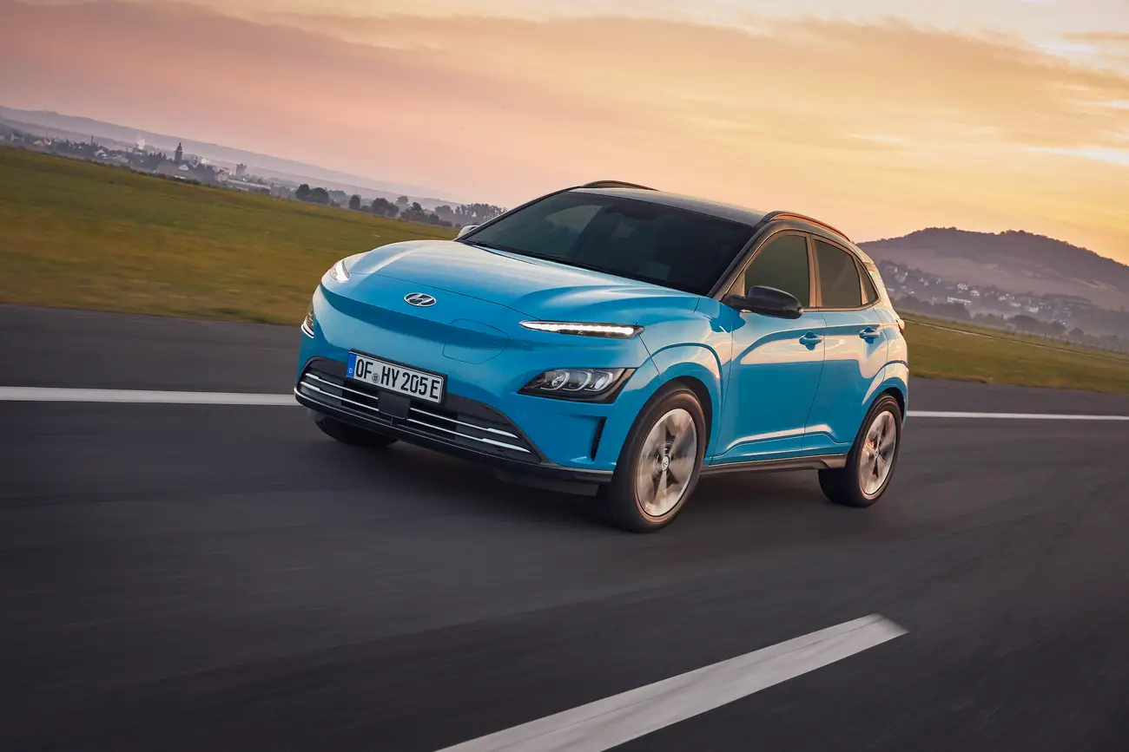
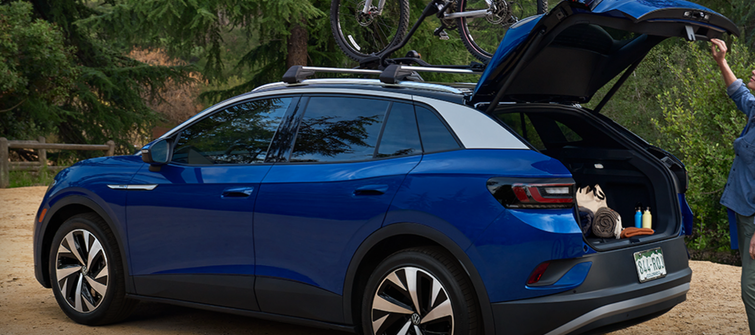
Buying Options
Purchasing Guide
All-Battery Electric Vehicles
Chevy Bolt
Hyundai Kona
Nissan Leaf
ECONOMY
MODELS
Kia Niro
Volkswagen ID.4
Notes:
PRESENTER 1
Plug-in hybrids typically can run in at least two modes: “all-electric,” where the motor and battery provide all the car’s energy, and “hybrid,” where both electricity and gasoline are used.

Slide 11
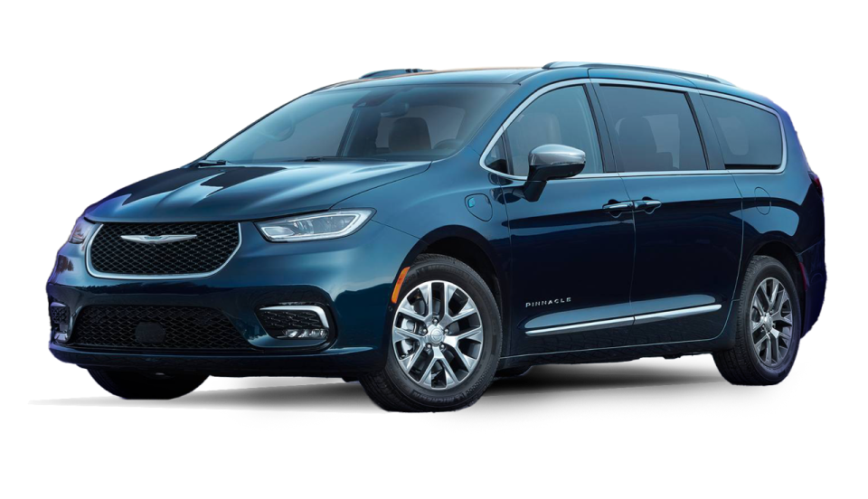
Buying Options
Purchasing Guide
Plug-In Hybrid Electric Vehicles
(Gas & Battery)
CONSIDER IF
AVERAGE RANGE
Daily commutes or frequent road trips would exceed battery range
Not ready to go full electric or there is only one car in your household
~15-50
Miles/in all electric mode
Notes:
Kalia
A PHEV has a gas engine and a smaller electric battery
You should consider an PHEV if you have:
Access to charging at home is not available: Not having reliable charging, having a back up gas tank will come in clutch in those moments you just dont have time to charge.
Daily commutes or frequent road trips would exceed battery range: Again, you need a vehicle that works with your commute. PHEV have smaller battery ranges, but the gas tank could support a longer commute.
Just as an example: My daily distance is about 15 to 20 miles going to work, the grocery store, or to the beach on a fun day. SO my daily commute would work with a model that has a lower range. However, I often visit my friends who live 3 hours south in San Luis Obispo. That trip is roughly 200 miles- so I would prefer a PHEV that i can drive electric in my community, but i can rely on the engine for long hauls to my friends or if I ever want to road trip up to San Francisco or Southern California.
You only have one car in the family: life is is busy, things get hectic, having a gas tank to back you up when you have multiple people needing to drive.
If a PHEV is what you need. A new model is closer to $40k and used sit roughly around $20k.

Slide 12
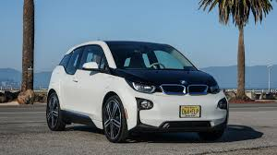
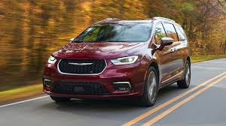
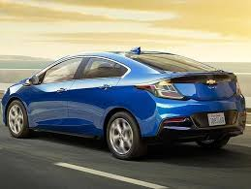
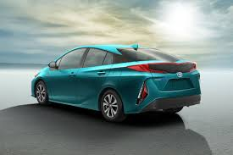
Buying Options
Purchasing Guide
Plug-In Hybrid Electric Vehicles (Gas & Battery)
Mini Cooper E
BMW i3
Chrysler Pacifica Hybrid
ECONOMY
MODELS
Chevy Volt
Toyota Prius Prime
Notes:
PRESENTER 1
Plug-in hybrids typically can run in at least two modes: “all-electric,” where the motor and battery provide all the car’s energy, and “hybrid,” where both electricity and gasoline are used.

Slide 13
An inside look Popular and Affordable Electric Vehicles
Notes:
Now we will play a video that will give you a more in-depth view into the most popular and affordable Electric vehicles on the market. Enjoy
I hope you enjoyed the video, and it gave you a better understanding of the different types of EVs on the market. As you can see, there is a wide variety of different models and styles you could choose from.

Slide 14
EV CHARGING
Notes:
BOTH PRESENTER

Slide 15
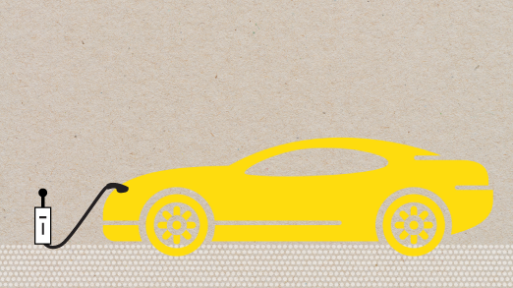
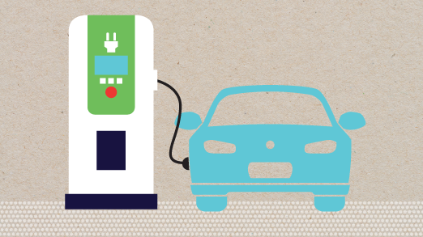
EV Charging 101
KNOW YOUR EV CHARGING STATIONS
AC Level One “smart outlet” | AC Level Two | DC Fast Charge
VOLTAGE 120V 1-Phase AC | VOLTAGE 208V or 240V 1-Phase AC | VOLTAGE 208V or 480V 3-Phase AC
AMPS 16 Amps | AMPS 12–80 Amps (Typ. 32 Amps) | AMPS <125 Amps (Typ. 60 Amps)
CHARGING LOADS 1.9 kW | CHARGING LOADS 3.8 to 19.2 kW (Typ. 7.69 kW) | CHARGING LOADS <350 kW (min. 50 kW)
CHARGE TIME FOR VEHICLE 5-6 Miles of Range Per Hour | CHARGE TIME FOR VEHICLE 10–20 Miles of Range Per Hour | CHARGE TIME FOR VEHICLE 100-200 miles in 30 Minutes
Notes:
PRESENTER 2
Level 1 – slowest method for refueling. charging plug into a standard 120v wall outlet and you’re going to get about 3-5 miles of range per hour which translates into about 40 miles of battery range
Perfect for PHEVs or topping of BEV batteries. Ideal for a typical commute of up to 40 miles!
Level 2 – faster method for refueling. Plug into a 240 volt outlet and get about 10-20 miles of range per hour which translates into 25 miles per hour of charging. Depending on the size and specifications of the battery, an all battery car can fully charge in 4-8 hours. Great for BEV, overnight charging will get you 160+ miles
Level 3 – DC Fast – you can get 100-200miles in 20-40 minutes depending on vehicle model and charging station. These chargers are only found in public. (types of connectors: Combined Charging System (up to 160 miles in 20 min) Chademo ( up to 67 miles in 30 min), tesla supercharger ( up to 200 miles in 20 minutes)

Slide 16
POLL
Charging
Notes:
Rank how accessible you think public EV chargers are with 1 being not very accessible and 5 being extremely accessible.

Slide 17
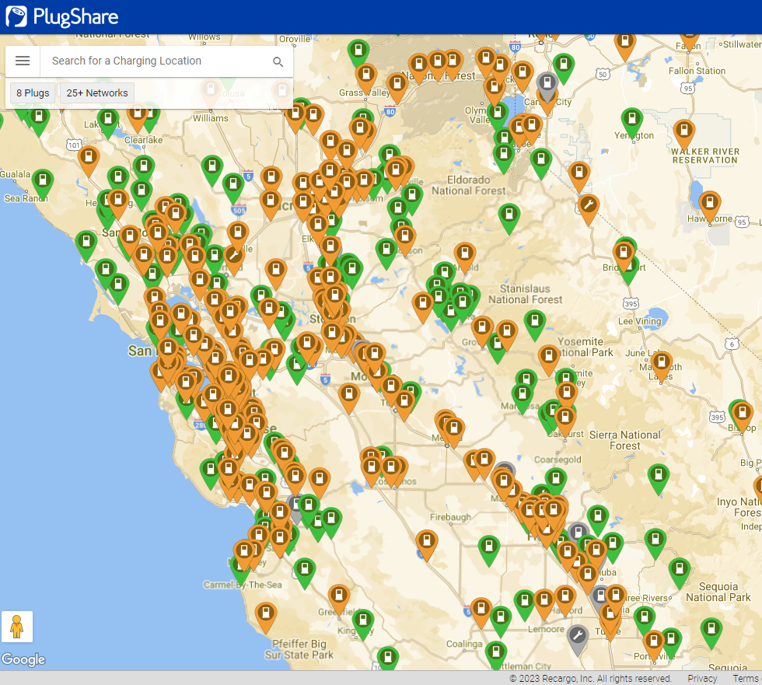
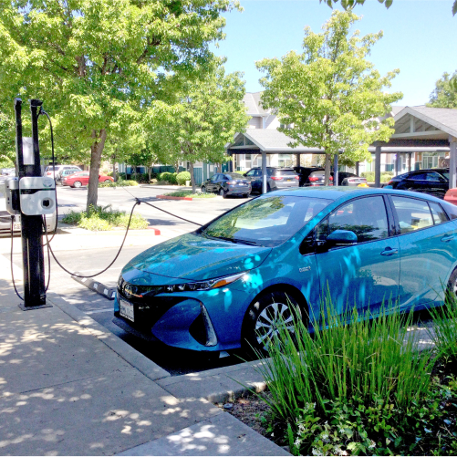
Public EV Charging is easy to find
EV Charging is coming soon or has already been installed at your property for convenient charging!
Plugshare.com
NEW: Infrastructure bill will create a charging network across the US. Find charging every 50 miles!
Plan road trips around charging stations on your route!
Notes:
PRESENTER 2
Click on Demonstrate how to use Plugshare map. Use example specific to MFH complex

Slide 18
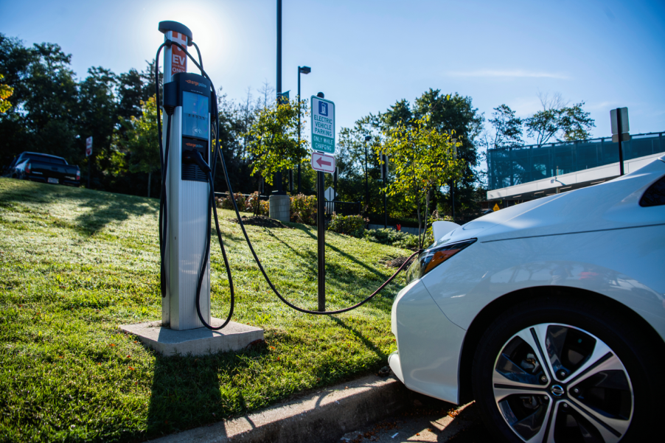
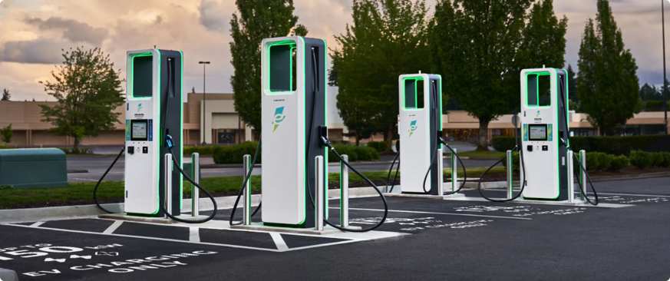
Cost of Public Charging
Level Two
Level Three
$10.00 to $25.00
To fully charge
$15.00 to $30.00
To fully charge
~7 cents per mile
18 to 40 cents per kWh
~11 cents per mile
35 to 55 cents per kWh
Factors impacting cost of charging include the size of your battery, how much charge you need, the rate of the charger.
Notes:
The average gasoline price is around $4.80 per gallon in California as of January 2025 Versus Electricity rates that average around $0.26 per kwh. With that pricing per 100 miles in a gas car you pay around $19.20 Versus EVs where per 100 miles you pay $7.40 to charge. EVs cost significantly less to drive per mile compared to gas cars.

Slide 19
Charging Options: Home Charging
Charging from home is the easiest way to charge your
electric vehicle.
Level One Charging:
Level one requires no installation as charging cables come free with car.
Cost: $5.00 - $15.00 (To fully charge)
Range: 3 – 5 miles/ per hour
Level Two Charging:
The cost of charging your vehicle at home depends on both battery size and price of electricity in your area. The cost is combined with your monthly electric bill.
Cost: $11.00 - $20.00 (To fully charge)
Range: 15 - 25 miles/ per hour

Slide 20
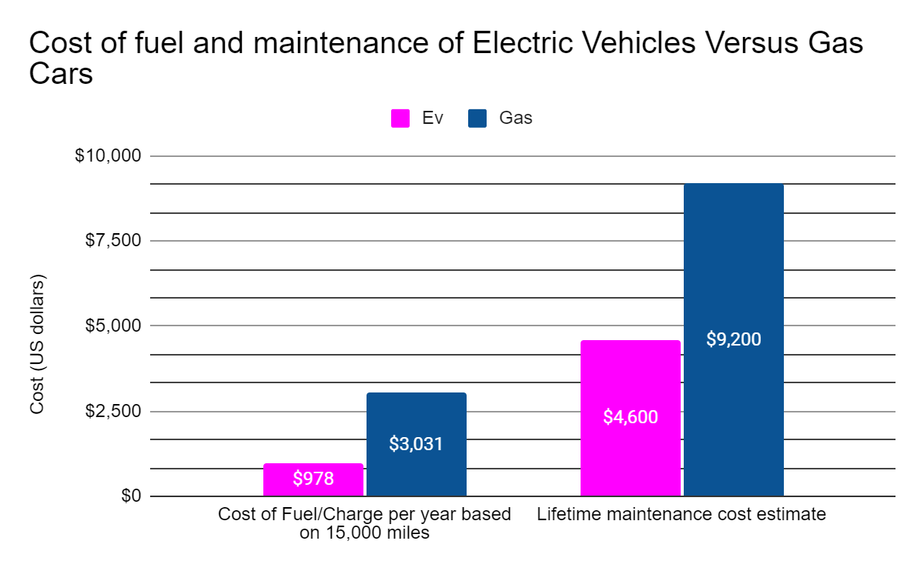
Cost Savings with EV Charging
The cents add up! You can save $2,053 (15,000 miles/year) on refueling by going electric
$4,600 in savings with EV
$2,053 in savings with EV
Data from Consumer Report
Notes:
Gas cars can range between
18 to 22 cents per mile
VS.
EVs can range between
6 to 16 cents per mile
The charging station can cost between $500-$700 depending on key features. Installation can cost between $400-$1200 depending on electrical capabilities
The cost of installing a level 2 charger at home will depend on the system you select, permitting fees specific to your area, and electrical capabilities.
The cost of charging your vehicle at home depends on both battery size and price of electricity in your area.

Slide 21
SUMMARY OF
Financial Incentives for Clean Vehicles
Notes:
PRESENTER 2

Slide 22
NEW VS. USED INCENTIVES FOR ALL-BATTERY EVS
EV Type | Incentive | Savings
New or Used | Drive Clean Assistance Program | Up to $7,500 (300% FPL or less)
New or Used | Federal Tax Credit | Up to $7,500 (New) and $4,000 (used)
 | Consumer Vehicle Assistance Program Vehicle Retirement Rebate | $1,500 (225% FPL)
 | Local utility or air district incentives | Amount varies
Used only | PG&E Pre-Owned EV rebate | $4,000 (80% of median income)
Additional rebates available by region!
Notes:
PRESENTER2
Key points:
The first two programs are received BEFORE you purchase or lease the car.
The remaining 4 you apply for AFTER you purchase or lease the car.
The Federal tax benefit is dependent upon your tax liability.
The rebates listed here are for battery EV for a lower income qualified household. Rebates on plug in hybrids and hybrids are less.

Slide 23
Purchase Scenario
2023 Chevy Bolt EUV
Timeline:
April July Sept
2023 2023 2023
Signed up for Purchased a Bolt EUV Received all her rebates
Alara received 1 grant and 3 rebates
& received a free level 2 charger!
Total savings: $23,000
purchase guidance
ALARA
Former Purchase Guidance participant

Slide 24
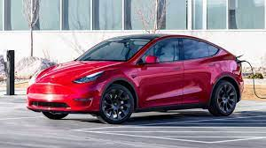
Purchase Scenario
2023 Tesla Model Y
Timeline:
Oct Oct Dec
2023 2023 2023
Signed up for Purchased a Tesla Model Y Received all rebates
George received 2 rebates
Total savings: $10,500
purchase guidance
George
Former purchase guidance participant

Slide 25
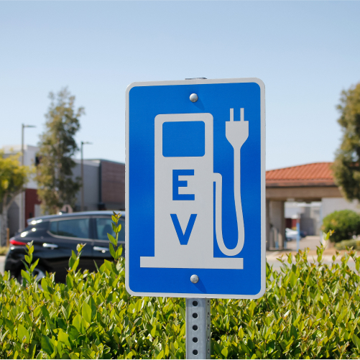
Do You Qualify for Incentives?
Some Incentive Guidelines
The year of the vehicle
The mileage
Income
Cost
Notes:
PRESENTER 2
So, at this point, most people want to know “Do I Qualify for a Grant? And if so, what documents do I need?” Again, here’s the income qualification chart that we looked at earlier. Basic documents needed are listed here: (go over chart
DON’T SHARE THIS BUT GOOD TO KNOW JUST IN CASE: BTW an AB 60 License is are for individuals who are unable to provide proof of legal presence in the United States (U.S.), but who meet California DMV requirements and can provide proof of identity and California residency.

Slide 26
PG&E Pre-Owned EV Rebate Program
How it works
Purchase or lease an eligible
pre-owned EV
Submit application within 180 days
If eligible receive a $1,000 rebate
Eligible Rebate Plus applicants
will receive a $4,000 Rebate
PG&E Pre-Owned Vehicle Rebate Income Requirements for Increased $4,000 Rebate
If you are enrolled in governmental assistance programs, you are eligible for an increased go to https://evrebates.pge.com/program-requirements to see if you qualify!

Slide 27
APPLYING FOR
Grants and Incentives Through Access Clean CA
Notes:
PRESENTER 1
The goal of this section is to understand the income verification process for grant applications and the usefulness of the benefits finder.

Slide 28
Access Clean CA Benefits Finder
This tool is funded by CARB and can help pre-qualify you for multiple programs before you buy a car!
Please click on the link below or scan the QR code to enter your own information:
https://app.accesscleanca.org/?invite=ecoact.3cc721ae
Notes:
PRESENTER 1
https://app.accesscleanca.org/?invite=ecoact.3cc721ae
Instructions to Presenter:
Put link into the meeting chat. Invite people to follow along and enter their personal information.
Open Benefits Finder and follow the process using
Danny’s Case Study Details:
$2k down payment
Salinas Zip Code 93906
Select “Yes” I have a vehicle to trade in. Year 2005
Which electric vehicle(s) are you interested in?
Select “Battery electric” and “Plug in Hybrid”
Public Transportation – Enter No
One-person household
Income is $50,000/year
Does family own home? - Enter Yes
What type of home? – Enter Single-Family
Electricity service provider – enter PG&E
Benefits Screen - Expand on all Benefit options
Check your inbox – move to next slide

Slide 29
Follow Up
Check your email and junk email:
Email from Access Clean CA (info@accesscleanca.org)
Click on Let’s Go!
The email will direct you to income verification that will make sure you are qualified to go through the program and receive grants and rebates.
Notes:
PRESENTER 1
It is very important you check your email. You should receive an email from Info@accesscleanca.org make sure to check your inbox and spam file. This email, like the visual on the right- click the orange lets go button to go the income verification application.

Slide 30
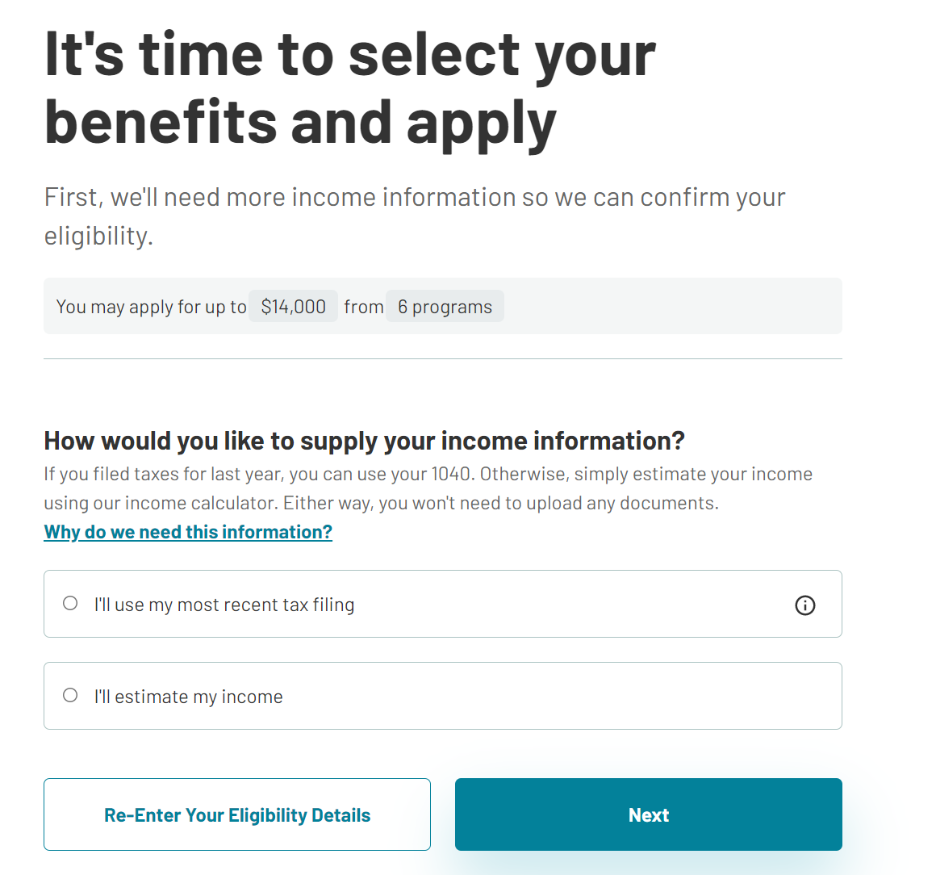
Follow Up on Income Verification
Income
Make sure to have your most recent tax information when walking through the income verification OR
Select I’ll estimate my income
Opportunities
Select the grants and incentives you want to apply to
Personal Details
Click submit!
Notes:
PRESENTER 1
You can either use your most recent tax filing or estimate your income. Once that information is complete, you’ll select which programs you are interested in applying for. We suggest selecting them all, so you have more options

Slide 31
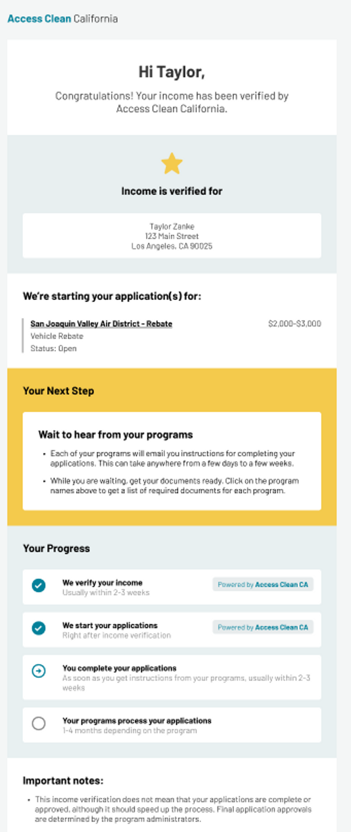
Access Clean CA: Affidavit and Approval
E-sign your Affidavit from Access Clean
Wait for Approval Email
Verifying your income takes four to six weeks. When it is complete you will receive email invitations to apply to the grant and rebate programs.
Notes:
The final step will be signing an affidavit to have Access Clean process and verify your income to check your elligibility for each of the programs you selected. This process takes around 4 to 6 weeks and you will receive an email confirmation when complete.

Slide 32
Next Steps & Homework
Notes:
PRESENTER 1

Slide 33
Timeline
PRE- PURCHASE:
Access Clean CA income verification takes 3-6 weeks
Grant takes 1-4 months to approve
POST-PURCHASE:
Rebates take 4-6 weeks to receive after purchase
The buying process can take anywhere from 3 – 8 months

Slide 34
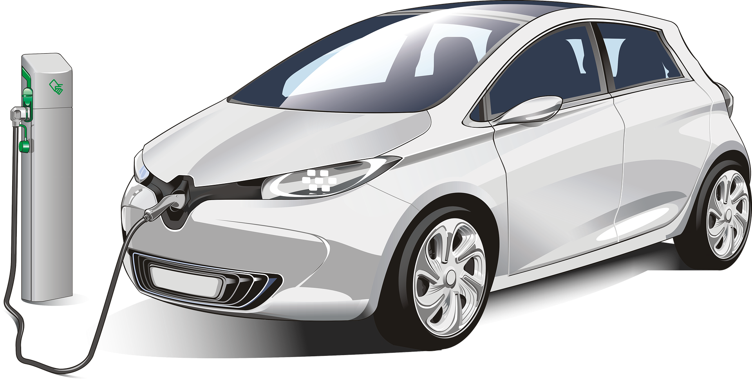
Explore your EV Options
New Cars
Used Cars
Use the VELOZ Electric for ALL
site to get prices on models you are interested in.
ElectricforALL.com
Craigs List
CarMax
Kelly Blue Book
cleanvehicles.cudlautosmart.com
Notes:
PRESENTER 1
We highly suggest you use the resources available to you online to research EVs you are interested in.
Electricforall.com
Craigs List
Car Max
Cleanvehicles.cudlautosmart.com
It's important to figure out which vehicles work best for your lifestyle and budget. Make sure to find a vehicle that fits your size, commuting, and style needs. It is also important to know the average cost of vehicles so you can get an honest and fair deal when you make a purchase.

Slide 35
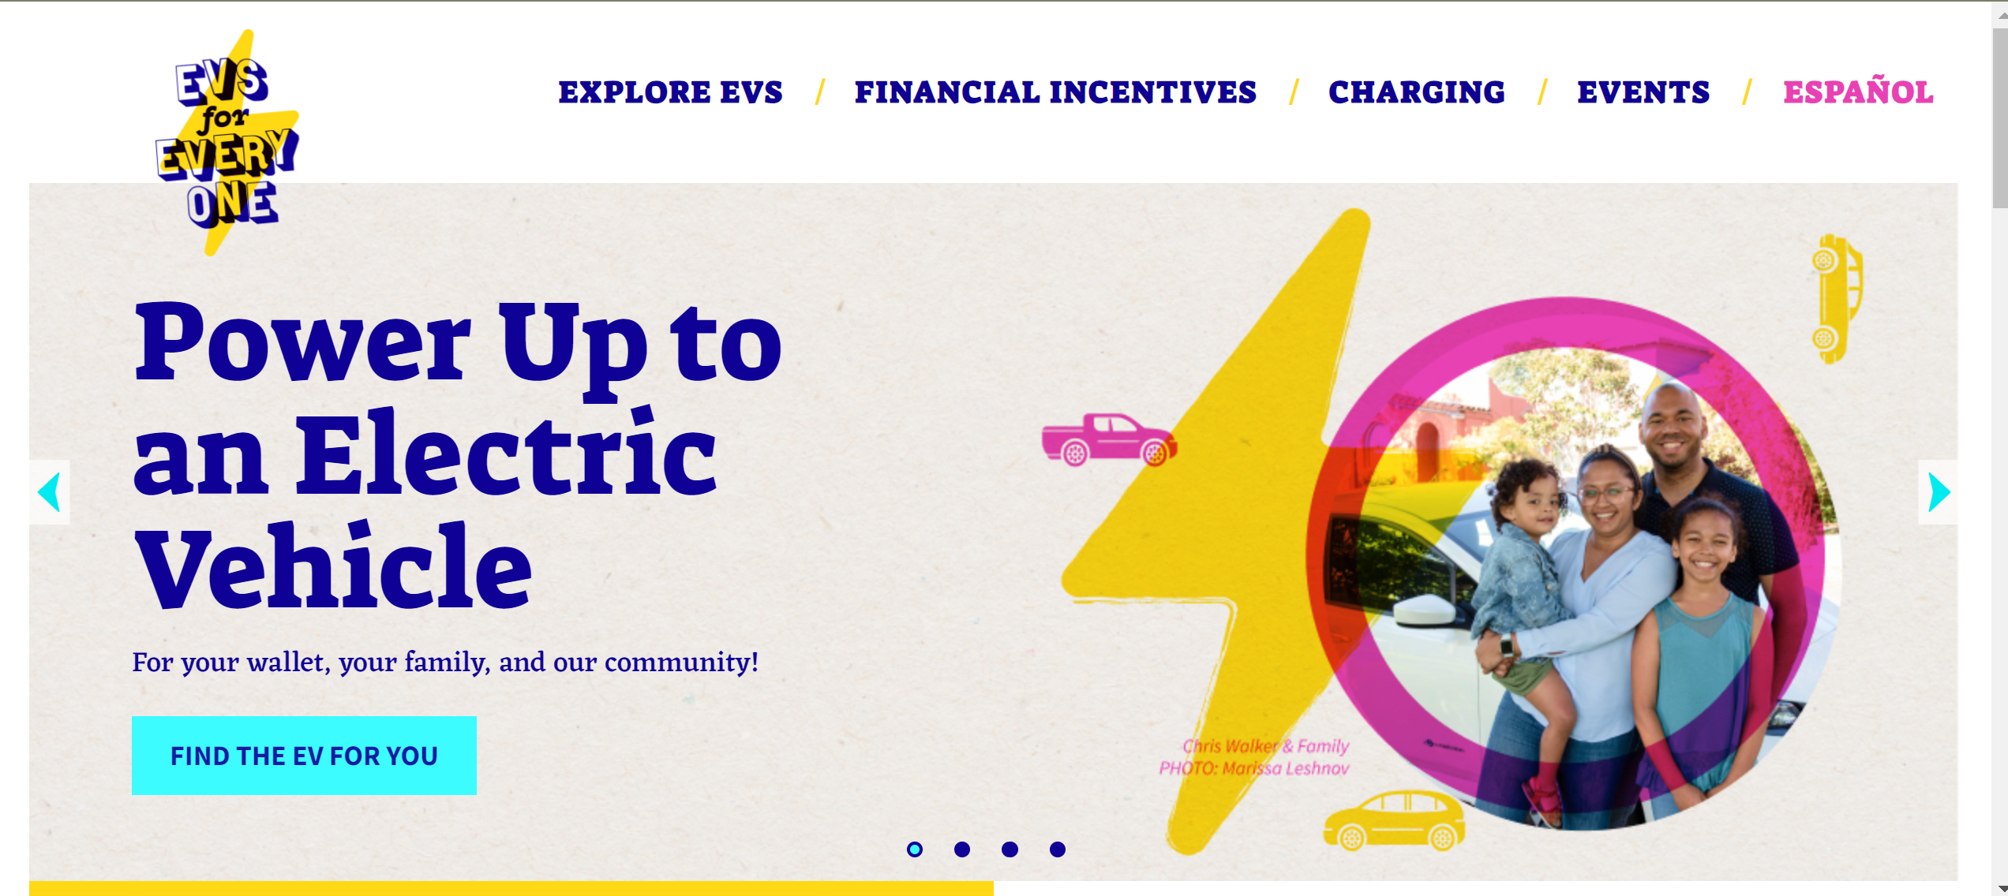
Ready to explore EV ownership?
Reach out to Grid Alternatives Care Team at Care@accesscleanca.org
If you live on the Central Coast
(Santa Cruz County to Ventura County)
Sign up for our FREE EV Assistance program and work with an advisor to answer all of EV questions!
Find us at: https://evsforeveryone.org/purchase-guidance
Notes:
If you’d like to move forward, there are a couple options. If you live in the bay or central valley, feel free to reach out to the care team at Access Clean for more support.
If you live on the Central Coast, Santa Cruz to Ventura County, sign up for our free Purchase Guidance program. We can assist you through the entire buying process. Go to EVs for Everyone.org to learn more

Slide 36
Questions
Notes:
BOTH PRESENTER

Slide 37
Thank you!
Danny Ordaz
EV Program Specialist
Danny.Ordaz@ecoact.org
Kalia Vaught
EV Program Coordinator
Kalia.Vaught@ecoact.org

Slide 38
Incentive Links
Incentives received BEFORE EV is purchased
Driving Clean Assistance Grant Program. Must submit an application to program. Currently Available Only for Santa Cruz County Residents.
California Clean Fuel Reward – Received during purchase at dealership.
Incentives received AFTER EV is purchased
State - Clean Vehicle Rebate Project
Monterey Bay Air Resource District
Central Coast Community Energy (CCCE)
California Consumer Assistance Vehicle Retirement Program
Federal Tax Credit

Slide 39
Audience Q&A Session
ⓘ Start presenting to display the audience questions on this slide.

